Slide 1
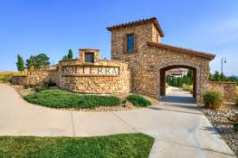
Solterra Landscape Committee
Community Engagement Session
May 11, 2024

Slide 2
Landscape Committee Charter Overall responsibilities of the committee and district Representative: The Landscaping Committee is hereby authorized to assist in the oversight of landscape services performed bon property within the Districts, and to make specific recommendations to the Districts’ Manager/Boards regarding ways to sustain and improve the efficiencies and /or effectiveness of such services. The Landscaping Committee does not have the authority to give directions and/or instructions to contractors, management, consultants, or employees of the Districts, unless otherwise approved by the Boards. The Landscaping Committee’s primary point of contact for coordinating reviews of landscaped area and meeting with relevant contractors is the Districts’ manager (Mat).

Slide 3
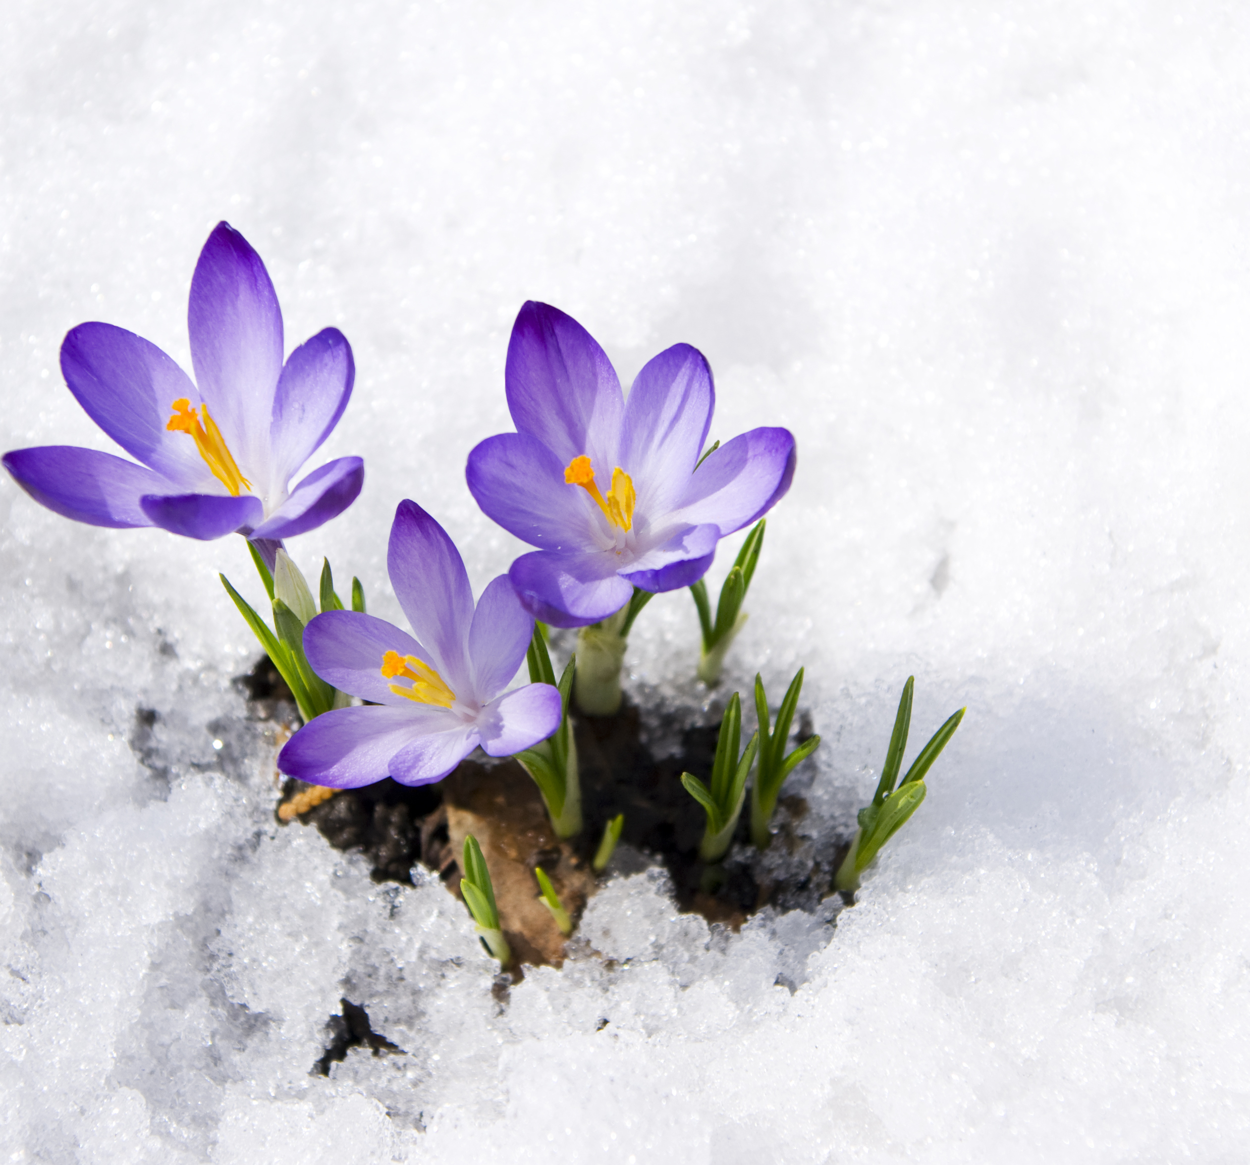
Annual landscaping process
1Q: Review budget for the year and prioritize beds/areas accordingly
2Q: Assess trees from winter for replacement. Reassess priority beds based on budget.
3Q: Start planning for following year budget by assessing beds up for replacement/revitalization
4Q: Forward planning and direction for district landscaper. Fall winterization/trimming

Slide 4
Landscaper annual schedule
Winter (February, March, and April)
Ornamental Grasses cut in February
Turf aerated in March
Preemergent, weed and feed applied in April
Irrigation system checked
Winter watering of trees as needed
Spring
Replace evergreens identified the previous year.
Repair beds identified the previous year for repair
Summer
Identify deciduous tress for replacement or remediation for fall
Identify rock beds to remediate in the spring of the next year.
Fall
Replace or remediate deciduous trees identified in the summer
Identify evergreen trees for replacement in the spring of next year

Slide 5
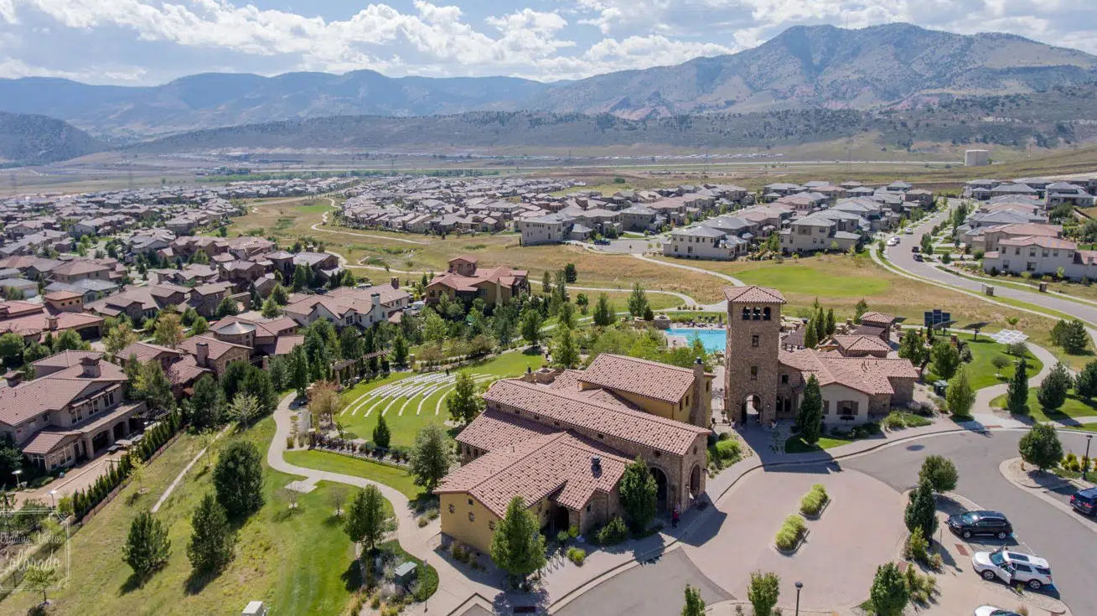
Community issues
Challenges facing the aesthetics of Solterra
Notes:
**Leean**
-xeriscaping efforts & forward thinking
-Schultz winter effort (plugging unused lines)
-Maturing plantings
-Test beds for successful plantings

Slide 6
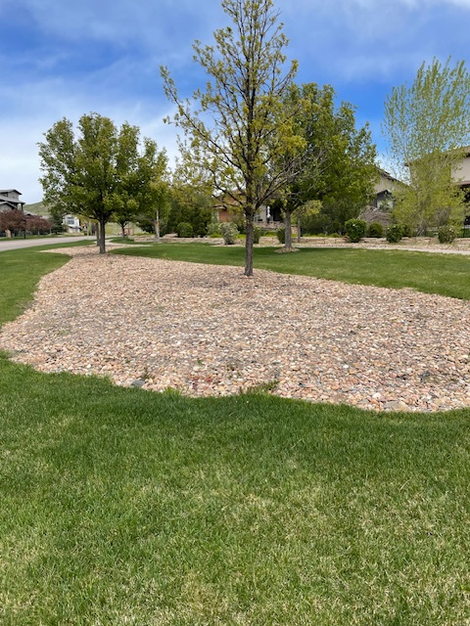
Xeriscape Solterra

Slide 7
Filing 15 2024 Planning

Slide 8
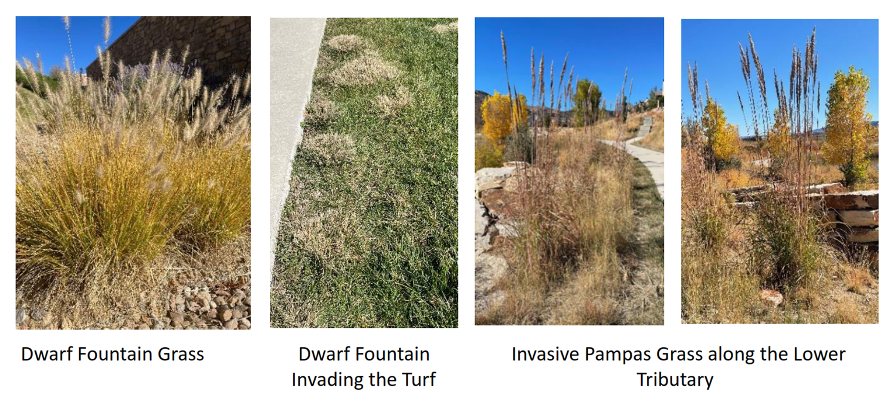
Invasive Species
Notes:
**Nancee**
-For dwarf fountain grasses replacements, utilize the recommended list found a few slides below.
-Damages from dwarf fountain grasses can be found throughout the community. Only way to stop further damage is expensive and requires the complete dig out of turf areas.
DO NOT DISCUSS ORGANIC VS. NON-ORGANIC PESTICIDES.

Slide 9
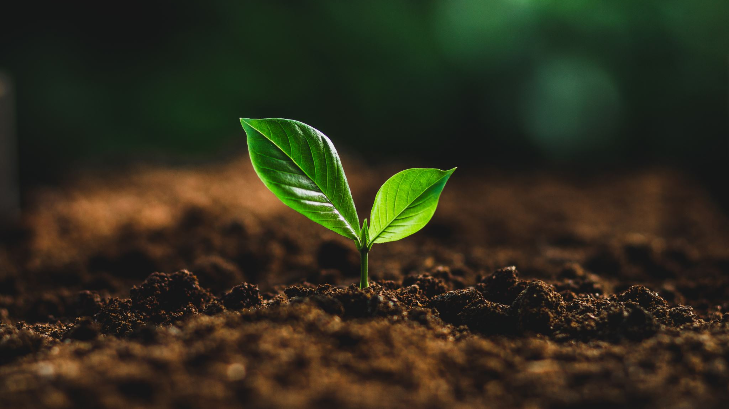
Solterra soil conditions & micro-climate
Landscaping differences throughout the years
Notes:
Solterra has clay/sandy soil. We also deal with a tremendous amount of wind and sun. The micro-climate here makes it rather difficult to grow certain plants & trees due to extreme conditions we face in comparison to other areas East of us.

Slide 10
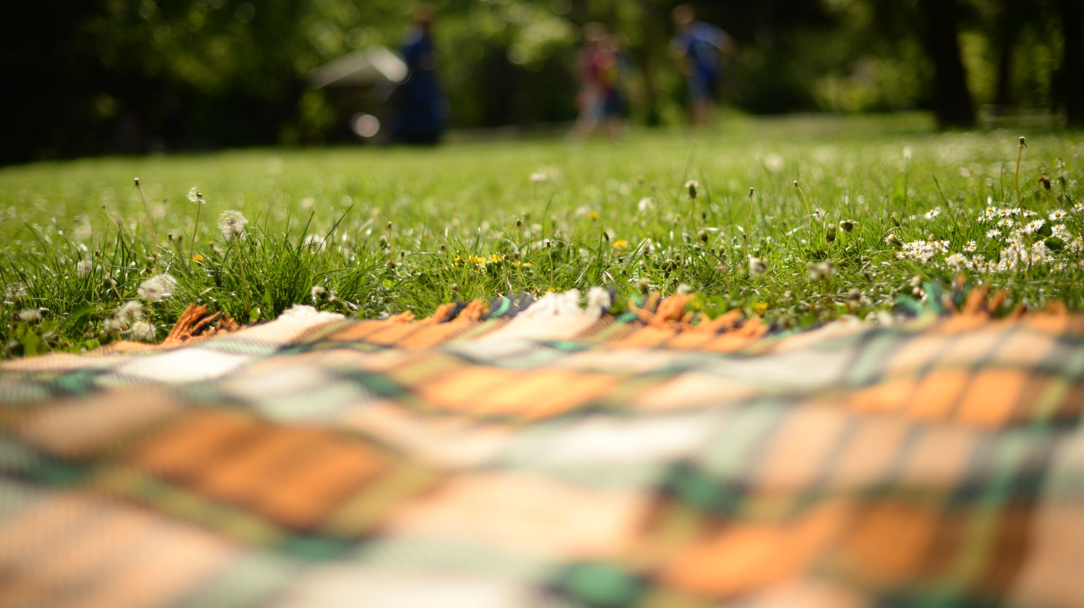
Landscape recommendations
Grasses:
Blue Avena Grass/ H
Karl Foerster Feather Reed Grass/ CA
Korean Feather Reed Grass/ CAB
Maiden Grass/ MSG
Morning Light Miscanthus/ MSML
Red Baron Japanese Blood Grass/ ICR
Undaunted Muhly Grass
Vines:
Virginia Creeper/ PCQ
Trees:
Prairie gem pear
Shadowblow serviceberry
Swamp white oak
Peach leaf willow
Ginnale maple
Bigtooth maple
Austrian Pines (evergreen)
Northern red oak
Rocky mountain maple
Limber Pine (evergreen)
Pinion Pine (evergreen)
Common Hackberry
Hot wings maple
Red tip maple
Perennials:
Alaska Shasta Daisy
Alpine Carpet Juniper/ JC
Andora Youngstown Juniper/ JH
Blizzard Mock Orange/ PLB
Bloody Geranium/ None
Broadmoor Juniper/ JSB
Buddleia Davidii Butterfly Bush
Chocolate Flower
Columbine
Columnar Buckthorn / RFC
Creeping Western Sandcherry / PB
Dalmatian Daisy (many varieties)
Dark Knight Bluemist Spirea/ CC
English Lavender
Evergreen Candytuft
Gay Feather
Goldfinger Potentillas
Goldstrum Black Eyed Susan (Rudbeckia)
Hyssop (many varieties)
Jacob's Beard
Japanese White Spirea/ WS
Knockout Dark Pink Rose
Knockout Red Rose/ RK
Lupinus Argenteus Lupine
Meidiland Fire Rose
26. Miss Kim Lilac / SP
27. Mohican Vibernum / VLM
28. Narbonne Blue Flax
Nine Bark
Orange California Fuchsia
Orange Carpet Hummingbird Trumpets
Paprika Yarrow (many varieties)
Pink Beauty Potentilla / PF
Prairie Jewel Penstemon (many varieties)
Prince of Wales Juniper/ JPW
Red Birds in a Tree Penstemon (many varieties)
Red Twig Dogwood
Red Valerian
Rose of Sharon
Russian Sage/ PAT
Russell Hybrid Lupine
Salvia (Many varieties)
Starburst Ice Plant (many varieities)
Tennessee Purple Cone Flower
Torchlily
Silver Sage
Valley Lavender Verbena
Variegated Sweet Iris
Viburnum Leatherlead
Zagreb Coreopsis
Notes:
www.plantselect.org
-Great resource regularly updated for viable Colorado plantings

Slide 11
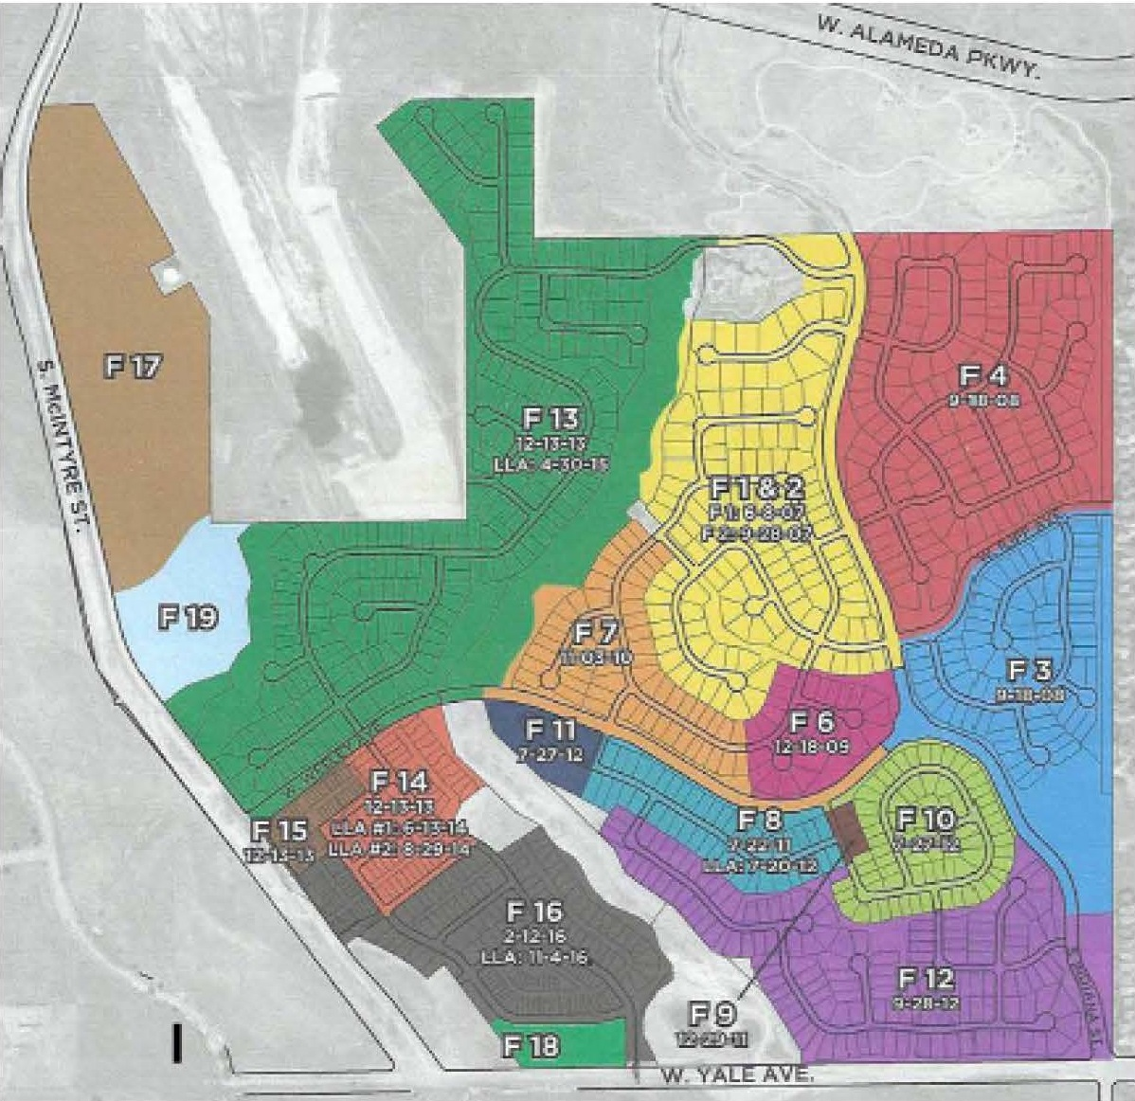
Filings map
Notes:
2024 focus has been on Filings 13-15 to bring these areas into the landscape committees standards set for Filings 1-12. This will be a 3-5 year focus as we face uncertain budgetary constraints.

Slide 12
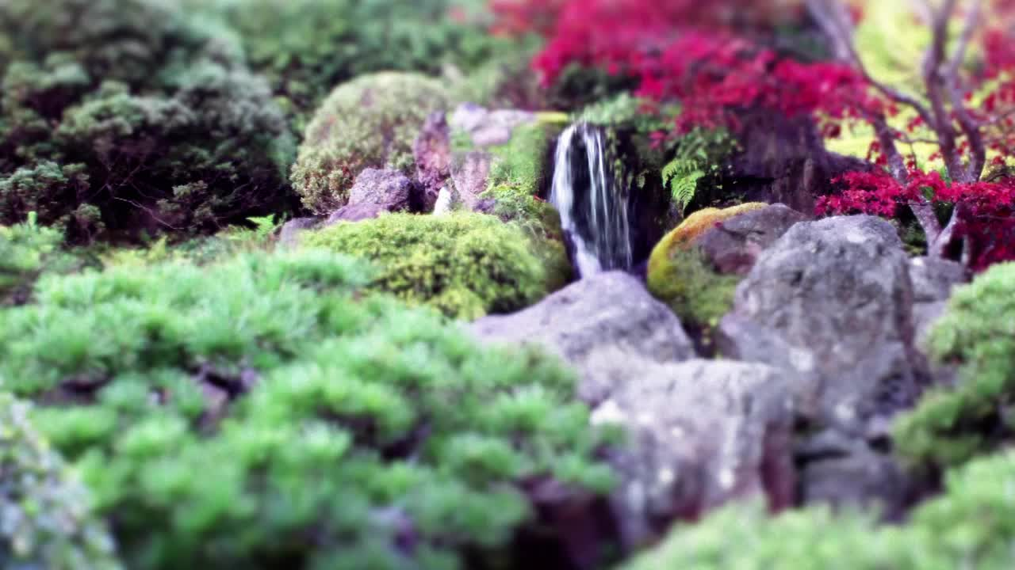
Volunteers needed!
The Solterra Landscaping Committee is comprised of members of this community that want to make an aesthetic impact to where we live & thrive. If you are interested, please reach out to solterralandscapingcommittee@gmail.com

Slide 13
Questions?
solterralandscapecommittee@gmail.com

